Slide 1


CALIFORNIA HOUSING MARKET
ANALYSIS
Avis Le, Kavi Gill, Giovonna Bendana, Miloni Kamdar, Ning Wang

Slide 2

Why did we choose California housing market?
Majority of our team lives in California
This subject had a large quantity of data that was accessible

Slide 3


What factors influence the costs of housing in California?
Income?
Region?
Ocean Proximity?
Housing Count?

Slide 4








What tools did we use?
Unite States Census
Google Maps API
Leaflet.JS
Zillow
Kaggle

Slide 5

What was our Set Up?
Jupyter Notebook
Pandas
Matplotlib

Slide 6
What were our challenges?
Getting started and picking topics
No coding experiences
Connecting APIs to data
Using the right graphs to display our findings

Slide 7
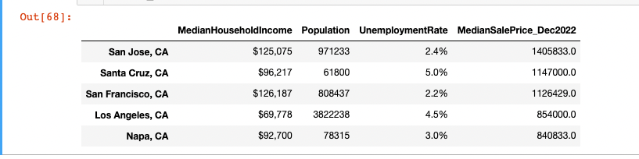
What were our findings?

Slide 8
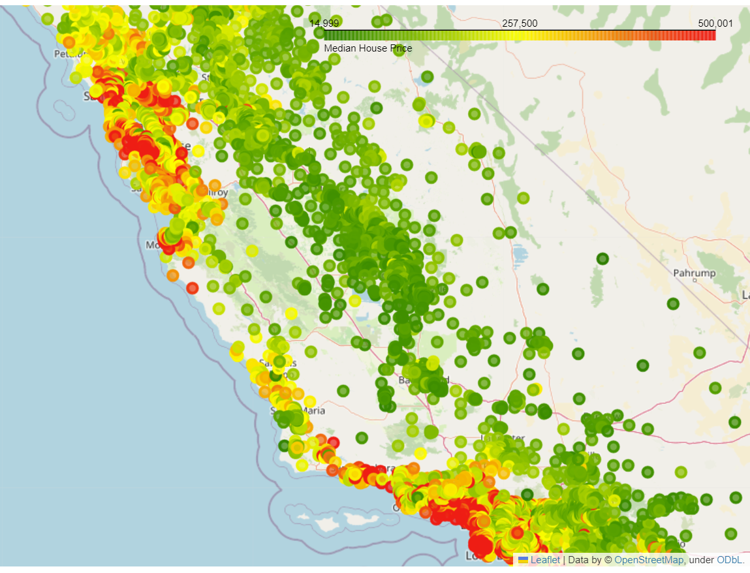
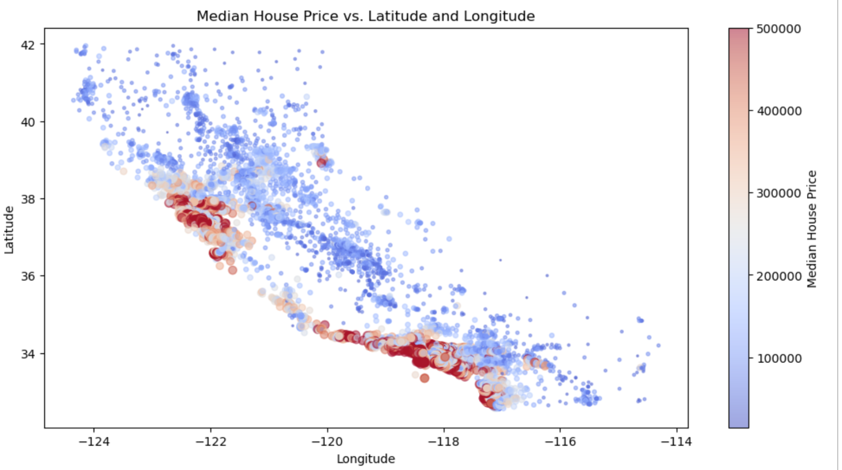
Our Maps

Slide 9
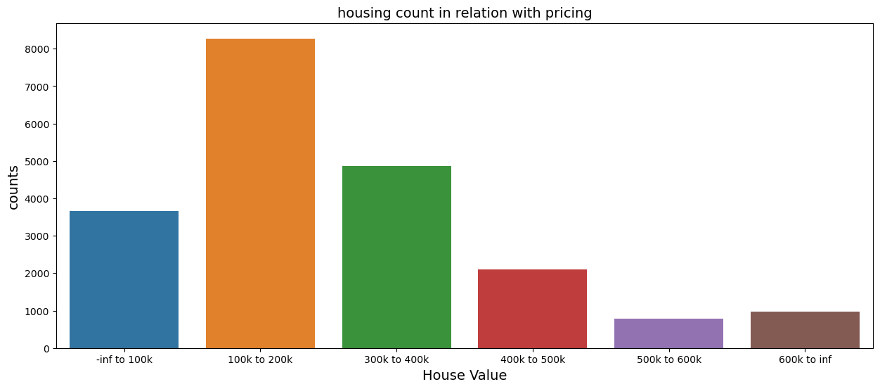
Our Visuals

Slide 10
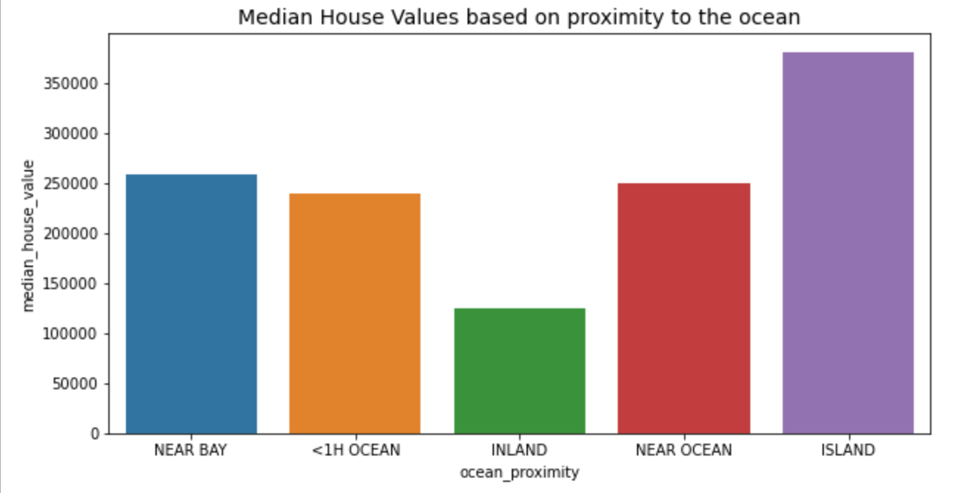
Our Visuals

Slide 11
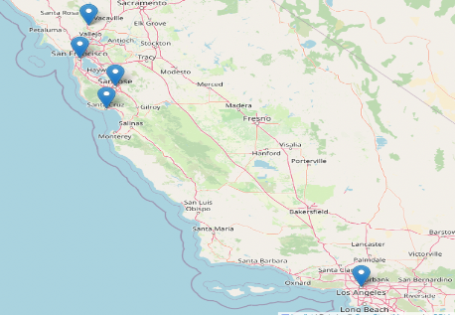
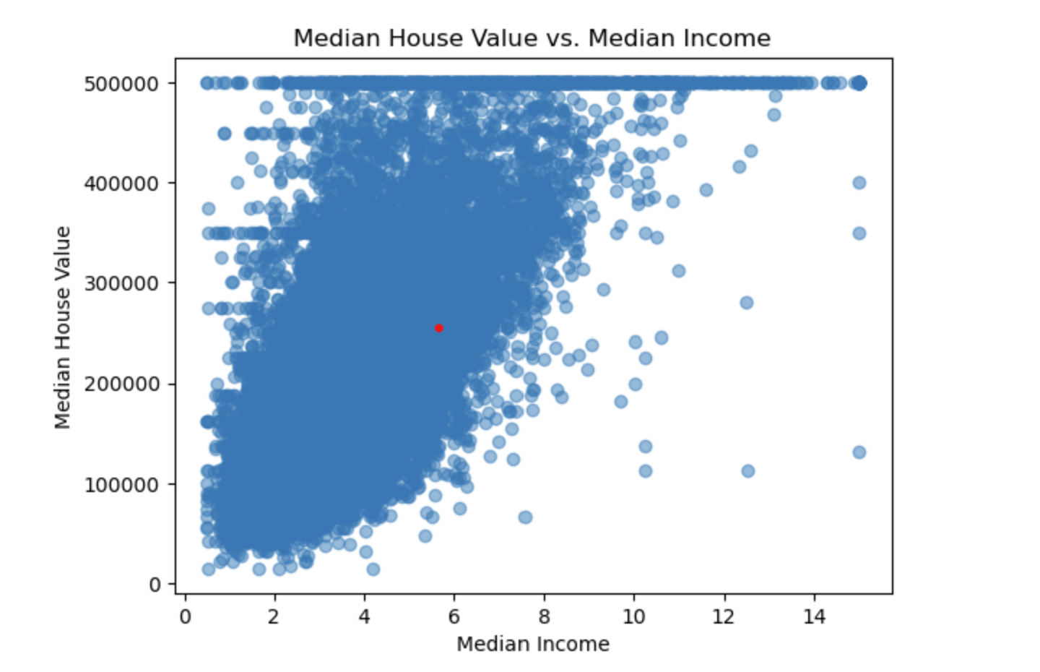
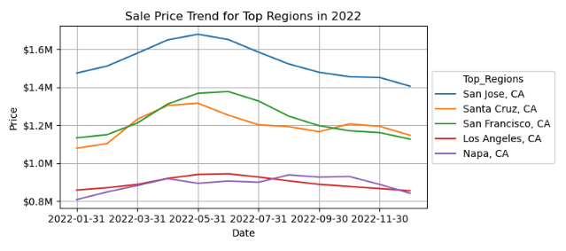
Our Visuals

Slide 12
What influences Housing costs
in California?
Regions that are highly populated
Median Income of each Household
Sales Price Trends

Slide 13
Thank You!

